Slide 1
BIKE RENTAL STORY TELLING

Slide 2
BIKE SHARING DATASET
Dataset Overview:
Spans hourly and daily counts of rental bikes from 2011 to 2012 in the Capital bikeshare system.
Includes weather and seasonal information, offering a comprehensive view of bike-sharing trends.
Bike-Sharing System Insight:
Represents a shift from traditional rentals, automating the entire process for over 500 global programs.
Contributes to addressing traffic congestion, environmental concerns, and public health on a large scale.
Research Opportunities:
The dataset's unique details, unlike other modes of transportation, enable explicit insights into travel duration, departure, and arrival positions.
Acts as a virtual sensor network, making it a valuable resource for research at the intersection of transportation, environmental science, and public health.

Slide 3
DATA DICTIONARY
instant: Record Index Index assigned to each record.
dteday: Date of the recorded data.
season: Seasonal category.
Values:1: Winter
2: Spring
3: Summer
4: Fall
yr: Year of the recorded data.
Values: 0: 2011 1: 2012
mnth: Month of the recorded data (1 to 12).
hr: Hour of the recorded data (0 to 23).
holiday: Indicates whether the day is a holiday or not.
Values: 0: Not a holiday 1: Holiday
weekday: Day of the Week
workingday: Indicates if the day is neither a weekend nor a holiday.
Values: 0: Not a working day
1: Working day
weathersit: Weather conditions at the time of recording.
Values: 1: Clear, Few clouds, Partly cloudy, Partly cloudy
2: Mist + Cloudy, Mist + Broken clouds, Mist + Few clouds, Mist
3: Light Snow, Light Rain + Thunderstorm + Scattered clouds, Light Rain + Scattered clouds
4: Heavy Rain + Ice Pallets + Thunderstorm + Mist, Snow + Fog
temp: Normalized Temperature in Celsius.
atemp: Normalized Feeling Temperature in Celsius.
hum: Normalized Humidity
(divided by 100).
windspeed: Normalized Wind Speed (divided by 67).
casual: Number of casual bike users.
registered: Number of registered bike users.
cnt: Total count of rental bikes, including both casual and registered users.

Slide 4
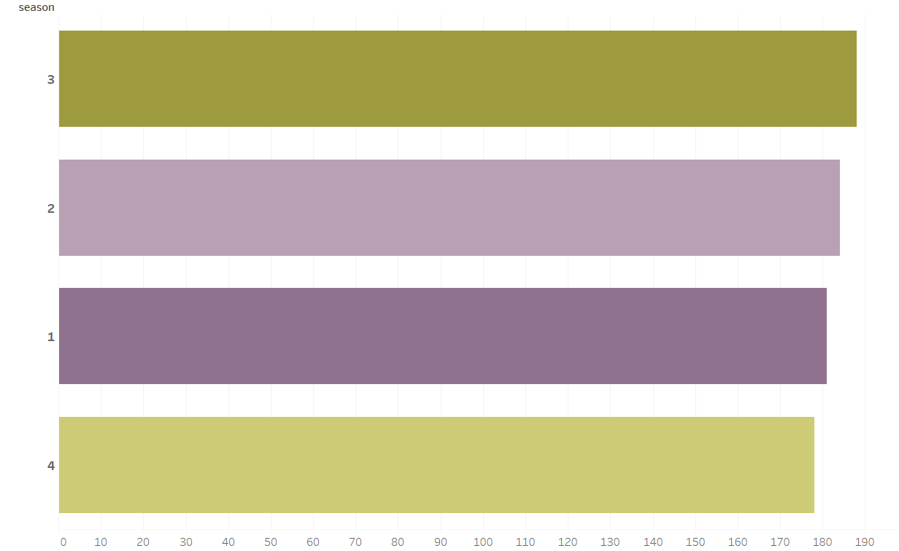
All The Seasons Are Equally Distributed
Summer is slightly more than other seasons by 10 days
Summer
Spring
Winter
Fall

Slide 5
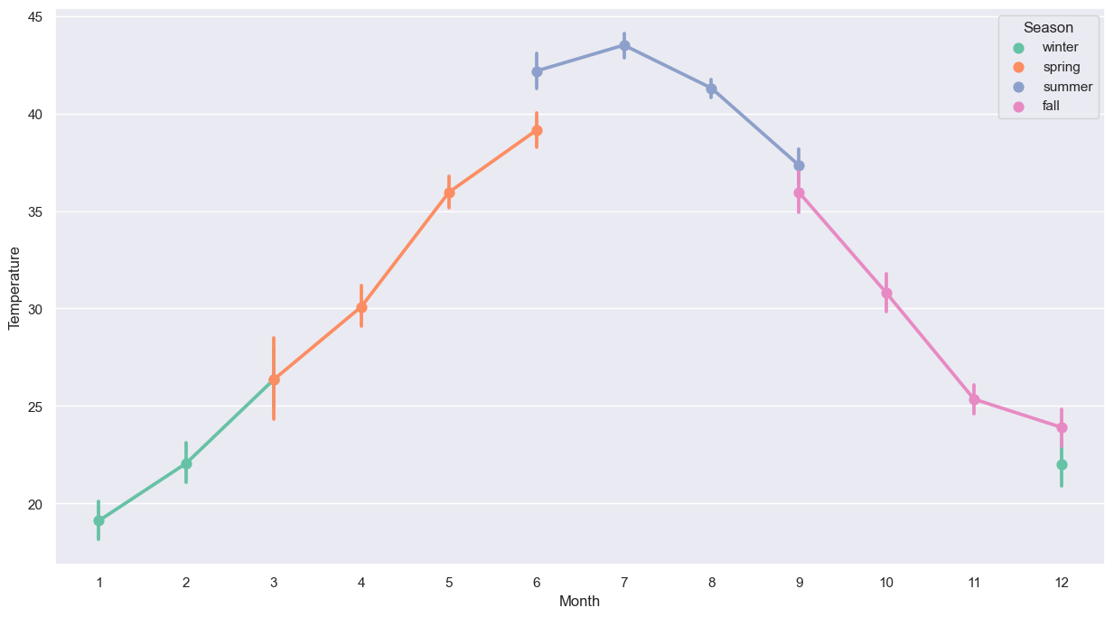
As The Temperature Values Are Normalized, It Forms A Bell Curve
Highest temperatures are observed in summer season months
The next higher temperatures are seen in spring

Slide 6
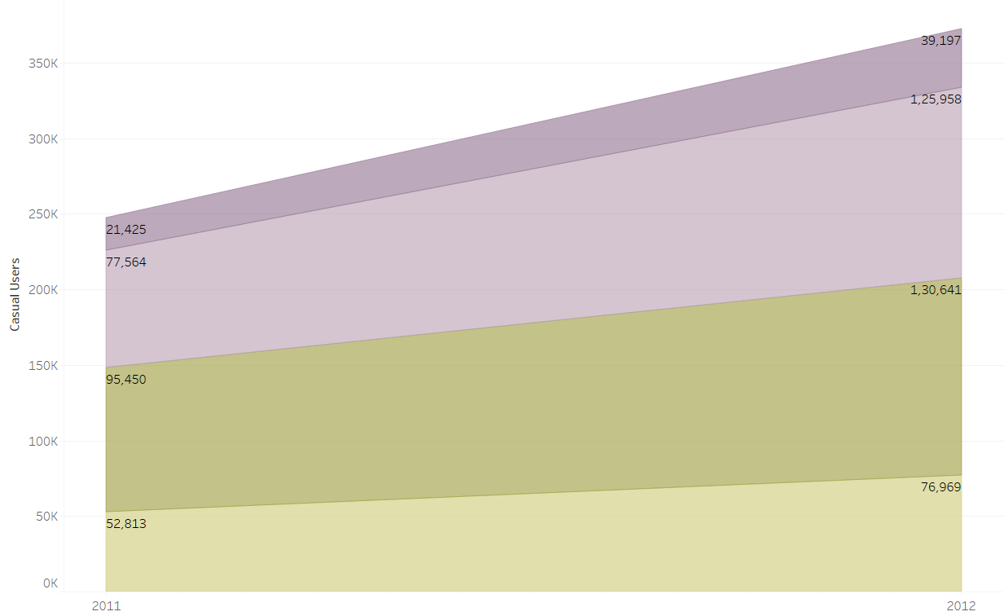
80% of bookings through casual users increased during winters
Winter
62%
83%
Spring
Spring season bookings stands at second place with more than 60% increase
37%
Summer
Fall
46%

Slide 7
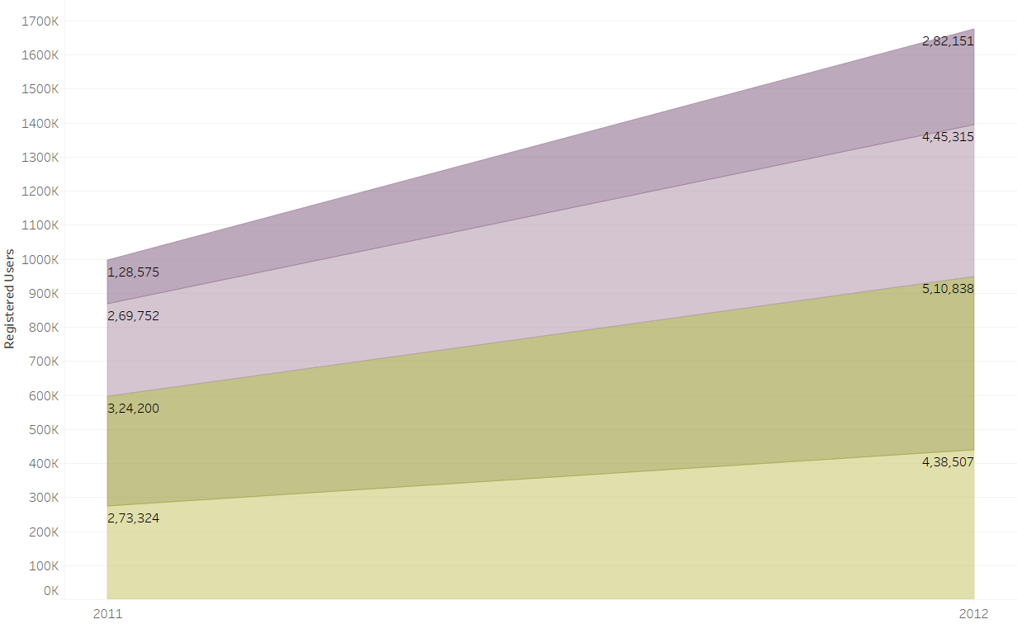
50% of bookings through registered users increased during winters
Winter
39%
54%
Spring
There is increase in bookings but very less compared to the bookings from Casual users
37%
Summer
Booking percentage increase remains constant in summer from both Casual & Registered Users
Fall
38%

Slide 8
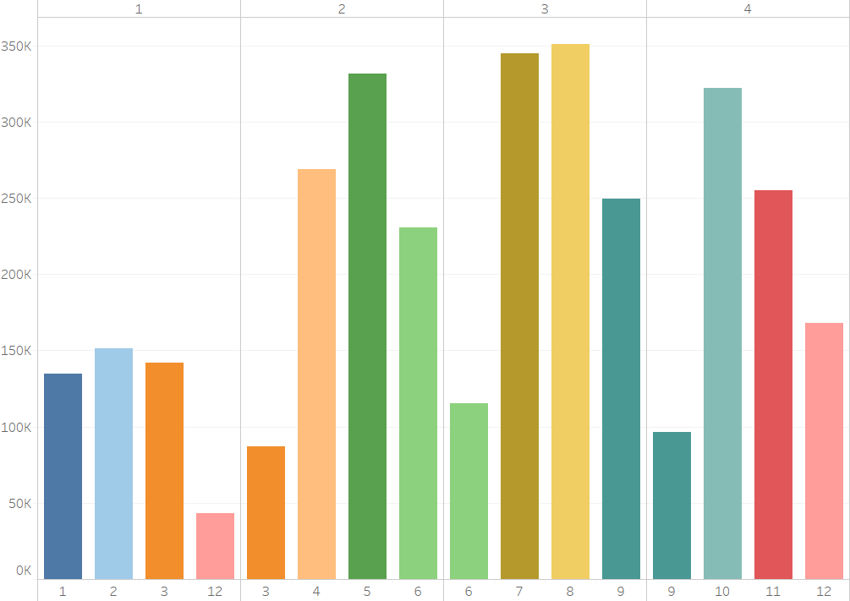
Summer Season Has The Highest Number Of Bike Rental Bookings
Winter
Spring
Summer
Fall
Even If it is a vacation month, bookings are very less
Mid-months of the seasons have the highest bike bookings

Slide 9
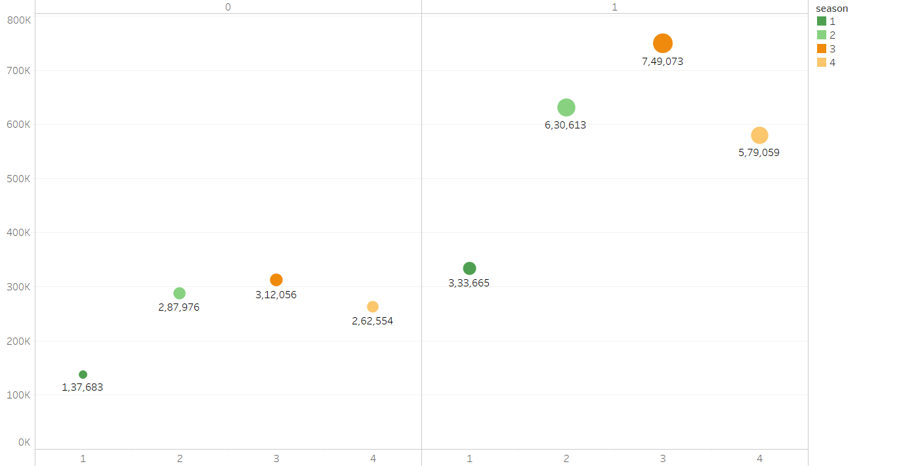
Bookings Are More During Working Days
Weekend/Holiday
Working Day
Winter
Spring
Summer
Fall

Slide 10
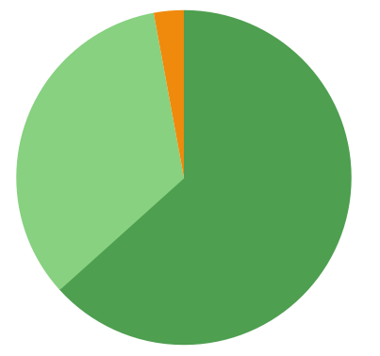
More Than 60% Bike Rentals Are Done During Clear Sky Days
3%
Light Snow, Light Rain + Thunderstorm + Scattered clouds, Light Rain + Scattered clouds
Mist + Cloudy, Mist + Broken clouds, Mist + Few clouds, Mist
34%
63%
Clear, Few clouds, Partly cloudy
This trend can be related to higher bookings during Summer & Spring seasons with clear sky weather situation

Slide 11
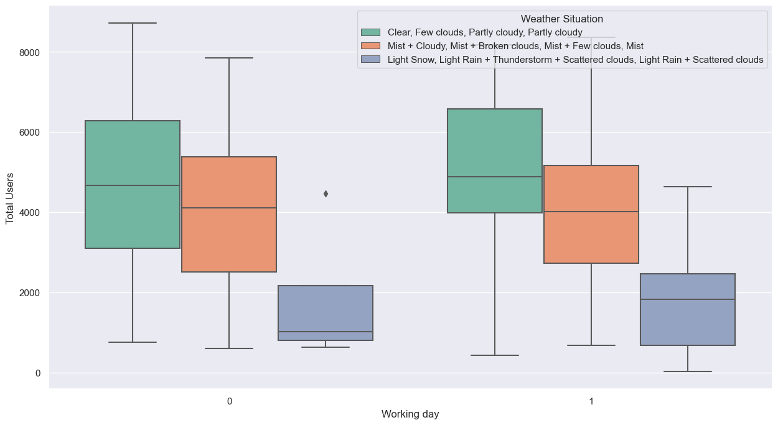
During A Working Day When The Weather Situation Is Clear And Partly Cloudy, Then The Bike Rentals Are Booked More.

Slide 12
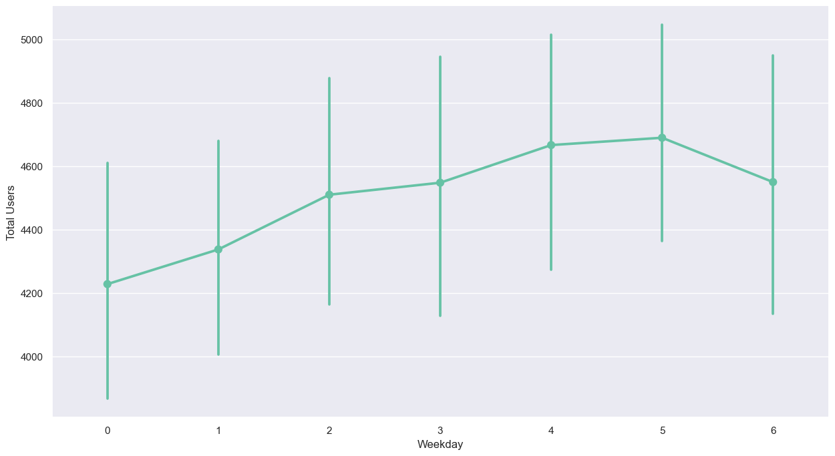
The Bookings Are Observed To Be More During Mid-week
We saw the bookings are higher during work days
From this graph another point can be added that during mid-week the bike rental bookings are more

Slide 13
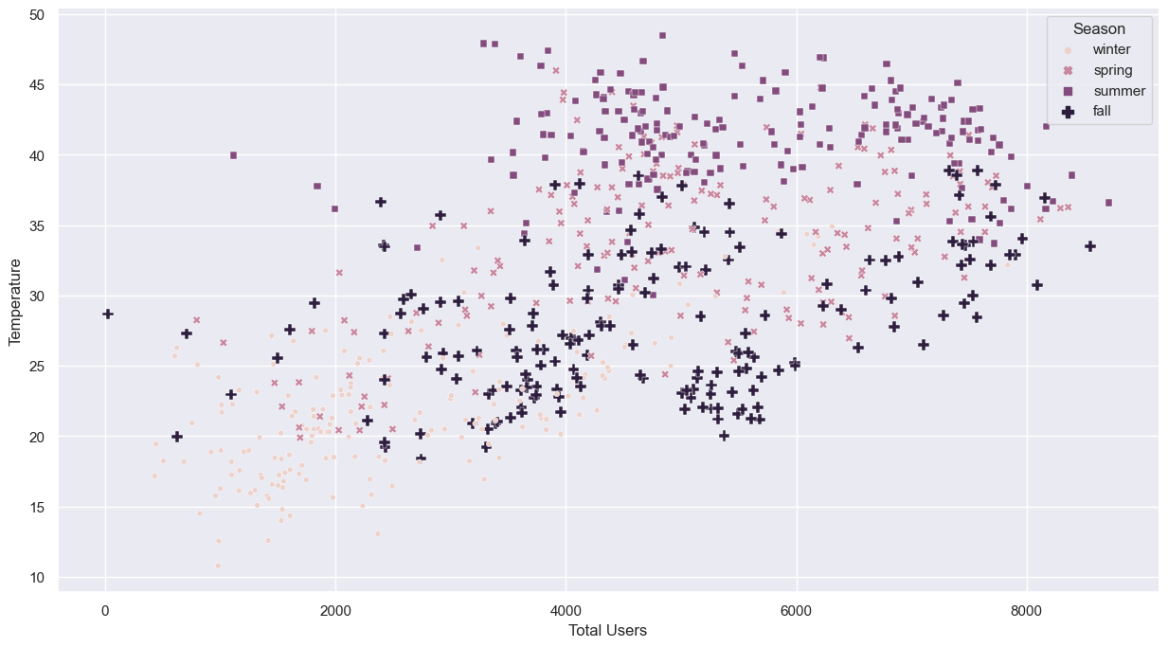
The Fall Season Booking are Consistent Where The Temperature Is Ranging Between 20C To 40C.
In winters where the temperature is below 20, the bookings are very low as travel by bikes.
In spring season, the bookings are very high when the temperature is in between 25C to 45C.
Summer season has the bookings when the temperatures are between 35C to 50C.

Slide 14
KEY TAKE AWAYS
Seasonal Distribution:
All seasons are approximately equally distributed.
Summer surpasses others by 10 days.
Temperature Trends:
Highest temperatures are recorded in summer, followed by spring.
Spring witnesses over 60% increase in bookings.
User Behavior:
80% increase in casual user bookings during winters.
Winter sees a 50% increase in bookings from registered users.
User Consistency:
Summer shows consistent booking percentage from both casual and registered users.
Spring and fall witness an increase in bookings, with casual users dominating.
Peak Booking Periods:
Summer dominates with the highest number of bike rental bookings.
Mid-months across seasons exhibit the highest booking rates.

Slide 15
KEY TAKE AWAYS
Booking Patterns:
Majority of bookings occur on working days.
Clear sky days correlate with over 60% of bike rentals, especially during summer and spring.
Weather and Workday Influence:
Clear and partly cloudy weather on working days leads to increased bike rentals.
Bookings are observed to be higher during mid-week.
Fall Season Consistency:
Fall season bookings remain consistent at temperatures between 20°C to 40°C.
Temperature Impact on Winter Bookings:
Winter bookings are low when temperatures fall below 20°C (up to 2000 users).
Spring and Summer Peaks:
Spring sees high bookings between 25°C to 45°C (2000 to 8000 users).
Summer bookings peak between 35°C to 50°C (4000 to 8000 users).

